Slide 1
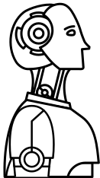
IOT PROJECT
DEV’S DESK
SMART DEVELOPER WORKSPACE
PRESENTED BY
MANICKA MEENAKSHI S (230701173)
LAVANYA R (230701162)

Slide 2
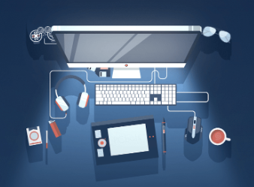
ABSTRACT
DevDesk is an IoT-powered workstation that aims to enhance both user productivity and well-being. By integrating motion sensors, OpenCV, and ultrasonic sensors, it tracks posture and blink rates, providing real-time feedback to correct posture and prevent eye strain. The system continuously monitors the user’s body angle and blink frequency, prompting timely breaks to reduce physical discomfort and eye fatigue using ESP32-CAM and OpenCV
In addition to ergonomic monitoring, DevDesk adapts the workspace environment to optimize user comfort. It adjusts factors such as screen brightness, air quality, and temperature, creating an ideal setting for improved focus and well-being. The system also tracks performance metrics, including battery and memory usage, to ensure seamless operation. By combining ergonomic improvements, environmental adjustments, and intelligent break reminders, DevDesk offers a comprehensive solution to boost productivity and enhance workplace health.Advances real time metrics like performance,network are also analysed

Slide 3
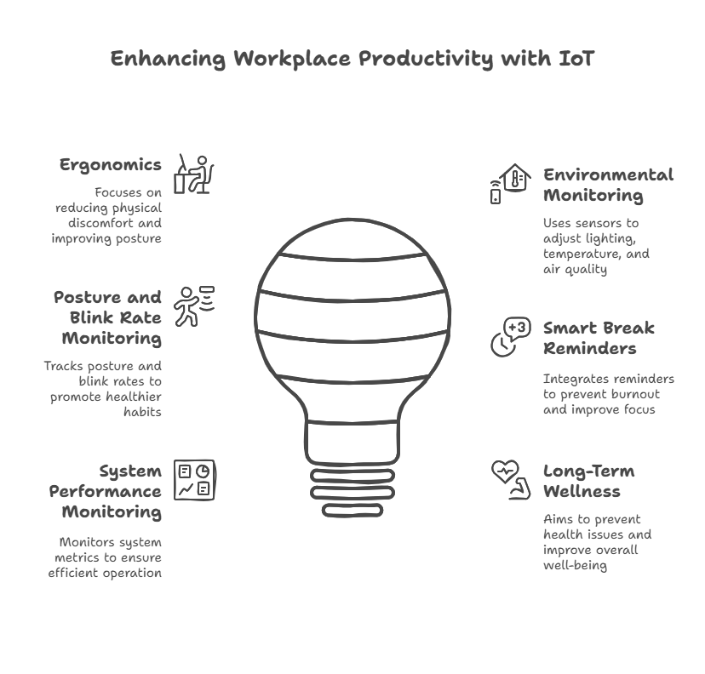
INTRODUCTION
The rapid advancement of technology has revolutionized workspaces, leading to the development of smart desk systems that integrate Internet of Things (IoT) technology for optimizing productivity and ensuring employee well-being. These systems utilize various sensors to monitor physical parameters such as posture, blink rate, and environmental factors like temperature, lighting, and air quality. By providing real-time feedback and personalized interventions, smart desks help reduce physical discomfort, eye strain, and burnout, promoting healthier work habits. Additionally, integrating productivity techniques like smart break reminders and system performance monitoring enhances focus and operational efficiency, creating an ideal workspace for both mental and physical health improvement.

Slide 4
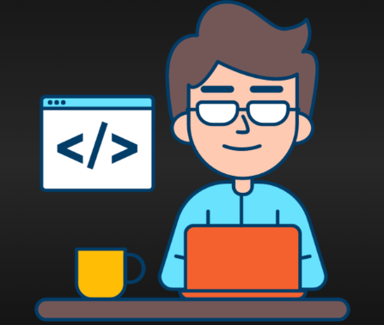
OBJECTIVES...
Centralized Developer Monitoring
Provide a unified dashboard to monitor system performance, network status, and device analytics, improving productivity and proactive debugging capabilities.
Empowering a Healthier Digital Routine
Encourages mindful screen habits and ergonomic posture through gentle nudges, supporting long-term wellness during extended work sessions.
Adapting to Your Environment Instantly
Responds intuitively to changes in light, comfort, and surroundings, offering a workspace that feels personal, balanced, and intelligent.
Smart Breaks for Balanced Focus
Gently encourages healthy screen habits with flexible micro-breaks inspired by the Pomodoro and 20-20-20 rule—neither strict nor lenient, just right.

Slide 5
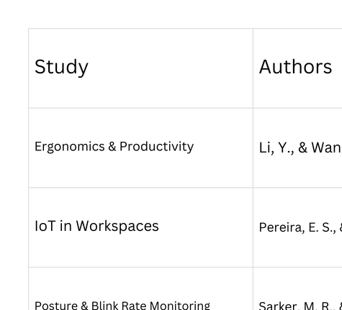
LITERATURE SURVEY

Slide 6
EXISTING SYTEMS..
01
02
03
04
LUMINI – AI WELLNESS ASSISTANT
ERGOCHAIR SMART APP
TIMEULAR
F.LUX
USES PHYSICAL TRACKER TO LOG WORK SESSIONS AND BREAKS.
Encourages mindful task management and screen-time balance.
ADJUSTS SCREEN BRIGHTNESS BASED ON TIME OF DAY.
Reduces blue light to ease eye strain and promote sleep.
Lightweight tool with minimal interference and max impact.
MONITORS POSTURE AND AMBIENT LIGHT TO REDUCE STRAIN.
TRACKS DAILY FOCUS AND WELLNESS SCORES THROUGH A CLEAN DASHBOARD.
SYNCS WITH SMART CHAIRS TO ANALYZE SITTING POSTURE.
GIVES GENTLE VIBRATION ALERTS TO CORRECT BAD HABITS.
OFFERS REPORTS ON POSTURE TRENDS AND ERGONOMICS TIPS.

Slide 7
PROPOSED SYSTEM
PAGE 05
1
OBJECTIVE
Dev’s Desk is a smart workspace sOLUTION THAT ENHANCES DEVELOPER PRODUCTIVITY AND WELL-BEING. IT USES IOT TO MONITOR POSTURE, EYE STRAIN, AND ENVIRONMENTAL COMFORT IN REAL TIME.
2
SENSOR INTEGRATION
The system integrates MPU6050 with Arduino Nano for posture tracking. Other sensors like ESP32-CAM(eye monitoring) , LDR(ambient light), DHT22, MQ135, YL-83, and INA219 are connected to ESP32 for multi-parameter monitoring.
3
IOT GATEWAY ARCHITECTURE
Arduino Nano and ESP32 form the IoT Gateway. ESP32 collects and processes sensor data and sends it to the cloud over Wi-Fi for analytics and automation.
4
CLOUD PROCESSING
SENSOR DATA IS STORED AND ANALYZED IN THE CLOUD. THE SYSTEM IDENTIFIES DISCOMFORT, PREDICTS ENVIRONMENTAL RISKS, AND TRIGGERS SMART ALERTS BASED ON USER BEHAVIOR.
04

Slide 8
5
DASHBOARD INTERFACE (REACT-BASED)
The React dashbOARD DISPLAYS REAL-TIME SENSOR READINGS, CAMERA SNAPSHOTS, AND SYSTEM HEALTH. USERS CAN CONTROL SETTINGS, RECEIVE ALERTS, AND TRACK WORKSPACE ANALYTICS.
01
6
SMART ALERTS & CONTROL
ALERTS ARE DELIVERED VIA BUZZER AND NOTIFICATIONS FOR POSTURE, BREAKS, AND ENVIRONMENT. THE SYSTEM ALSO INCLUDES 20-20-20 EYE STRAIN MONITORING, REMINDING USERS TO TAKE EYE BREAKS EVERY 20 MINUTES. BRIGHTNESS AND FOCUS MODE ARE AUTOMATED TO SUPPORT A DISTRACTION-FREE WORKFLOW.
7
OUTCOME
DEV’S DESK CREATES A HEALTHIER, SMARTER, AND MORE FOCUSED WORKING ENVIRONMENT. IT COMBINES IOT INTELLIGENCE WITH A CLEAN INTERFACE TO SUPPORT DAILY DEVELOPER NEEDS.

Slide 9
MODULES
1
POSTURE AND EYE MONITORING MODULE
Technologies Used: ESP32-CAM32, Ultrasonic Sensor, Motion Sensor, OpenCV
This module detects the user’s body angle and posture using motion and ultrasonic sensors. OpenCV processes live video from ESP32-CAM32 to monitor blink rate and eye dryness, promoting better ergonomics and reducing eye strain.Avoid eye strain using 20-20-20 rule.
2
SYSTEM PERFORMANCE AND ANALYTICS MODULE
Technologies Used: ESP32, Battery & Memory Monitoring
Monitors system health, including battery level, memory usage, and network performance. Ensures uninterrupted functionality and provides feedback to the user about the workstation’s status.
01
3
BREAK REMINDER AND PRODUCTIVITY MODULE
Technologies Used: ESP32, Timer Logic (Pomodoro Technique), Alerts
Implements smart break reminders based on time intervals and productivity techniques like the Pomodoro method. Encourages regular short and long breaks to reduce fatigue and boost mental focus.
4
SMART ALERTS & CONTROL
Alerts are delivered via buzzer and notifications for posture, breaks, and environment. The system also includes 20-20-20 eye strain monitoring, reminding users to take eye breaks every 20 minutes. Brightness and focus mode are automated to support a distraction-free workflow.
01

Slide 10
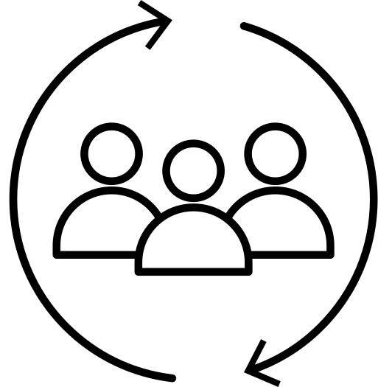
STEP 1 : PURPOSE AND REQUIREMENT SPECIFICATION
THE PRIMARY PURPOSE OF DEV’S DESK IS TO CREATE A SMART DEVELOPER WORKSPACE THAT ENHANCES PRODUCTIVITY, PROMOTES ERGONOMIC HEALTH, AND ENSURES ENVIRONMENTAL COMFORT USING IOT. THE SYSTEM CONTINUOUSLY MONITORS USER POSTURE, EYE STRAIN, AMBIENT BRIGHTNESS, AIR QUALITY, POWER USAGE, AND ENVIRONMENTAL CONDITIONS.
FUNCTIONAL REQUIREMENTS:
DETECT AND ALERT POOR POSTURE USING MPU6050
MONITOR EYE BLINKS AND APPLY 20-20-20 RULE VIA ESP32-CAM
CONTROL SCREEN BRIGHTNESS BASED ON AMBIENT LIGHT USING LDR
TRACK TEMPERATURE, HUMIDITY, AND AIR QUALITY WITH DHT22 AND MQ135
NOTIFY WATER LEAKAGE VIA YL-83 SENSOR
MONITOR POWER CONSUMPTION THROUGH INA219
DISPLAY REAL-TIME DATA AND ALERTS THROUGH A REACT DASHBOARD
PROVIDE CLOUD-BASED ANALYTICS AND NOTIFICATIONS
INTEGRATE GIT PULL/PUSH ACTIVITY MONITORING WITH NOTIFICATIONS FOR DEVELOPER AWARENESS
NON-FUNCTIONAL REQUIREMENTS:
REAL-TIME DATA PROCESSING AND CLOUD INTEGRATION
MODULAR, SCALABLE, AND USER-FRIENDLY DASHBOARD
ENERGY-EFFICIENT SENSOR USAGE AND LOW-POWER MODES
EASY DEPLOYMENT AND MAINTENANCE OF BOTH HARDWARE AND SOFTWARE
HIGH AVAILABILITY AND SYSTEM
RELIABILITY
WIRELESS COMMUNICATION WITH LOW
LATENCY
SECURE DATA TRANSMISSION AND USER
PRIVACY

Slide 11
STEP 2 : PROCESS SPECIFICATION
DEV’S DESK PROCESSES ARE DESIGNED FOR REAL-TIME SENSING, ANALYSIS, AND ALERTS BASED ON USER AND ENVIRONMENTAL INPUTS
POSTURE MONITORING
MPU6050 TRACKS NECK POSTURE AND ALERTS THE USER IF SLOUCHING IS DETECTED.
EYE STRAIN DETECTION
ESP32-CAM WITH OPENCV MONITORS BLINK RATE AND TRIGGERS 20-20-20 REMINDERS TO REDUCE EYE STRAIN.
BRIGHTNESS CONTROL
LDR SENSOR ADJUSTS SCREEN BRIGHTNESS AND SWITCHES TO DARK MODE IN LOW LIGHT.
ENVIRONMENTAL MONITORING
DHT22 AND MQ135 MONITOR TEMPERATURE, HUMIDITY, AND AIR QUALITY, SENDING ALERTS IF UNSAFE.
WATER LEAK DETECTION
YL-83 SENSOR DETECTS FLUID NEAR DEVICES AND TRIGGERS IMMEDIATE WARNINGS.
POWER MONITORING
INA219 TRACKS VOLTAGE AND CURRENT, HIGHLIGHTING ABNORMAL POWER USAGE.
GIT NOTIFICATIONS
GIT ACTIVITY (PULL/PUSH) IS DETECTED VIA WEBHOOK/API AND DISPLAYED AS REAL-TIME ALERTS.
DATA DISPLAY & CONTROL
SENSOR DATA IS VISUALIZED ON A REACT DASHBOARD WITH CONTROL FEATURES AND ANALYTICS.
1
5
2
6
7
3
4
8

Slide 12
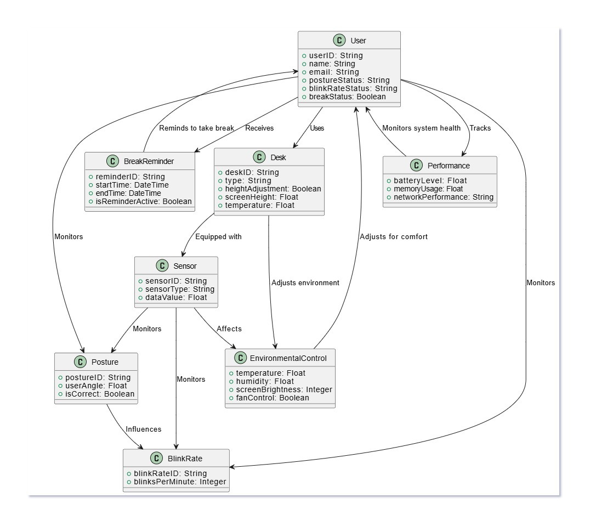
STEP 3 : DOMAIN SPECIFICATION
1) USER :
INTERACTS WITH THE SYSTEM AND IS MONITORED FOR POSTURE, BLINKING, AND BREAKS.
2) DESK :
USED BY THE USER; EQUIPPED WITH SENSORS AND RECEIVES BREAK REMINDERS.
3) SENSOR :
INSTALLED IN THE DESK; MONITORS POSTURE, ENVIRONMENT, AND OTHER CONDITIONS.
4) POSTURE :
TRACKED BY SENSORS; INFLUENCES BLINK RATE AND HELPS ASSESS USER ERGONOMICS.
5) BLINKRATE :
DETERMINES EYE STRAIN BASED ON POSTURE; MONITORED FOR USER WELLNESS.
6) ENVIRONMENTAL CONTROL :
ADJUSTS TEMPERATURE, BRIGHTNESS, AND COMFORT BASED ON SENSOR DATA.
7) BREAK REMINDER :
NOTIFIES THE USER WHEN IT’S TIME TO TAKE A BREAK BASED ON POSTURE OR BLINK RATE.
8) PERFORMANCE :
MONITORS THE SYSTEM’S HEALTH TO ENSURE RELIABLE OPERATION.

Slide 13
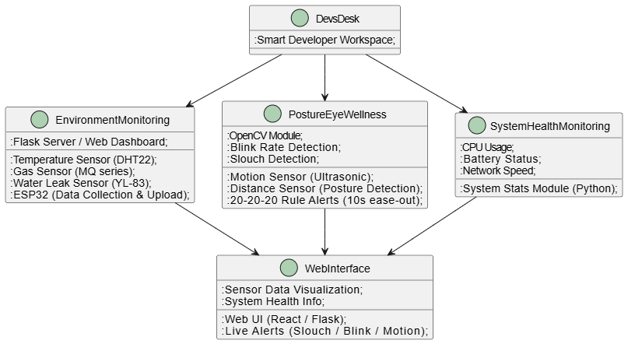
STEP 4 : INFORMATION SPECIFICATION
1. MAIN PROJECT OVERVIEW (DEV'S DESK)
GOAL: SMART WORKSPACE FOR DEVELOPERS.
FEATURES: ENVIRONMENT MONITORING, POSTURE CORRECTION, EYE WELLNESS, SYSTEM HEALTH.
2. ENVIRONMENT MONITORING MODULE
SENSORS: TEMPERATURE (DHT22), GAS (MQ SERIES), WATER LEAK (YL-83).
CONTROLLER: ESP32 (DATA COLLECTION).
INTERFACE: FLASK SERVER FOR VISUALIZATION.
3. POSTURE & EYE WELLNESS MODULE
SENSORS: MOTION (ULTRASONIC), DISTANCE (POSTURE).
OPENCV: BLINK RATE, SLOUCH DETECTION.
ALERTS: 20-20-20 RULE FOR EYE WELLNESS.
4. SYSTEM HEALTH MONITORING MODULE
METRICS: CPU USAGE, BATTERY STATUS, NETWORK SPEED.
INTEGRATION: SYSTEM STATS PROCESSING (PYTHON).
5. WEB INTERFACE
UI: REACT FRONTEND, FLASK BACKEND.
LIVE UPDATES: ALERTS, DATA VISUALIZATION, SYSTEM HEALTH.

Slide 14
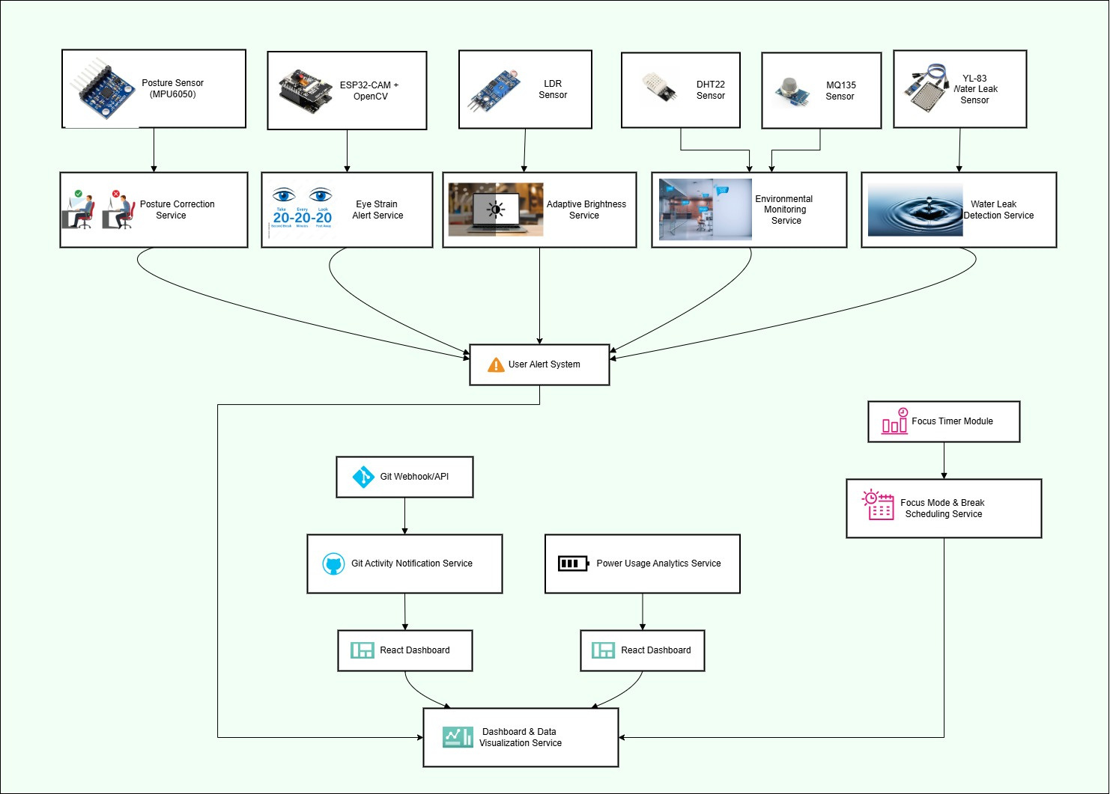
STEP 5 : SERVICE SPECIFICATION

Slide 15
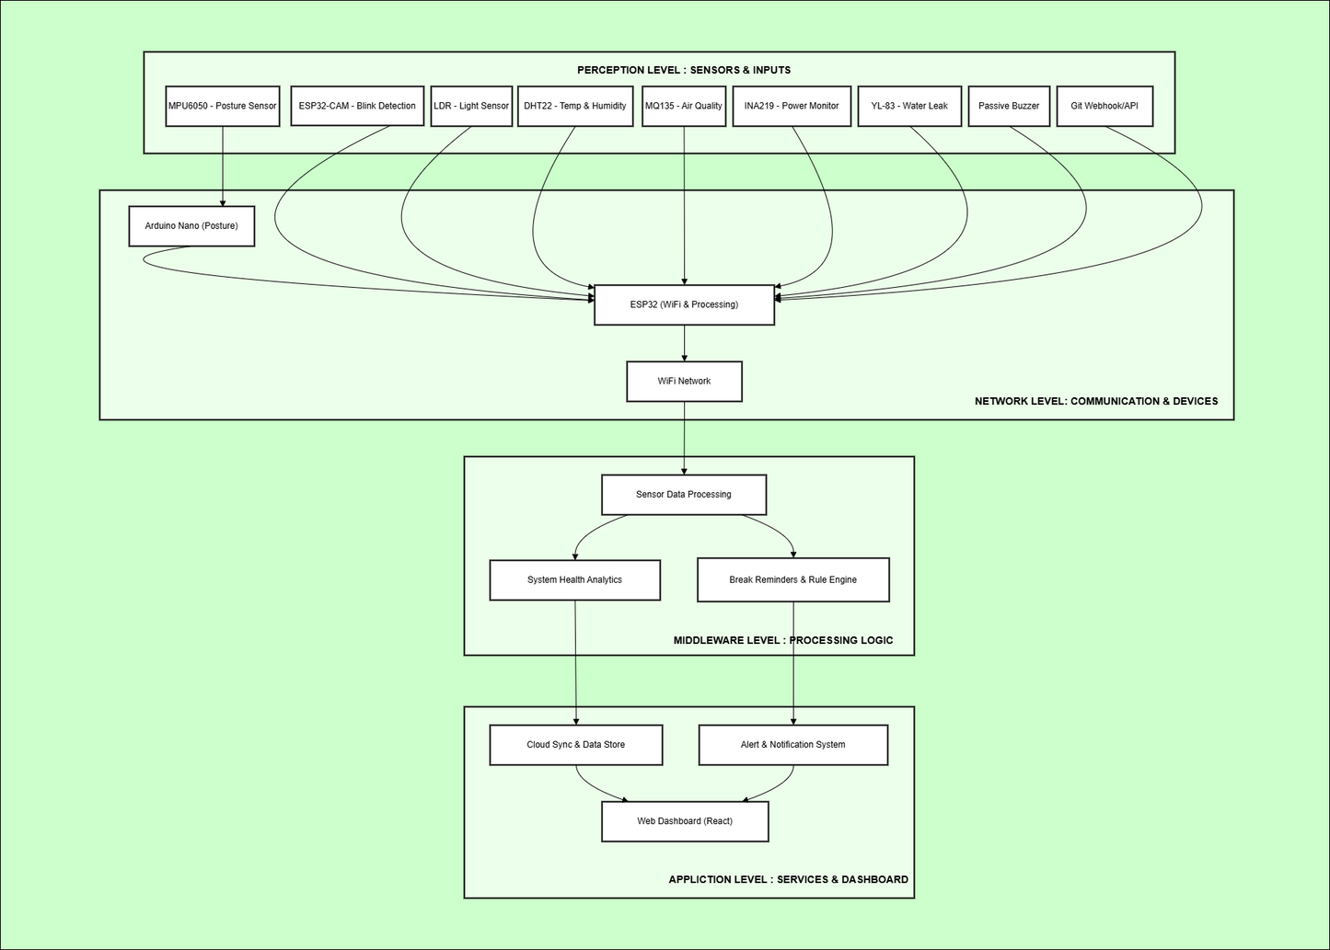
STEP 6 : IOT LEVEL SPECIFICATION

Slide 16
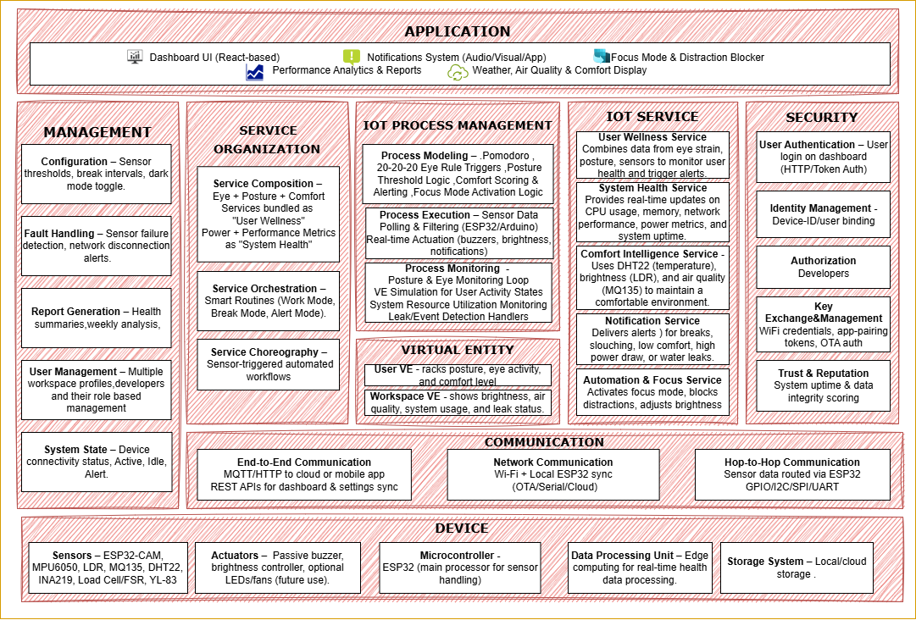
STEP 7 : FUNCTIONAL VIEW

Slide 17
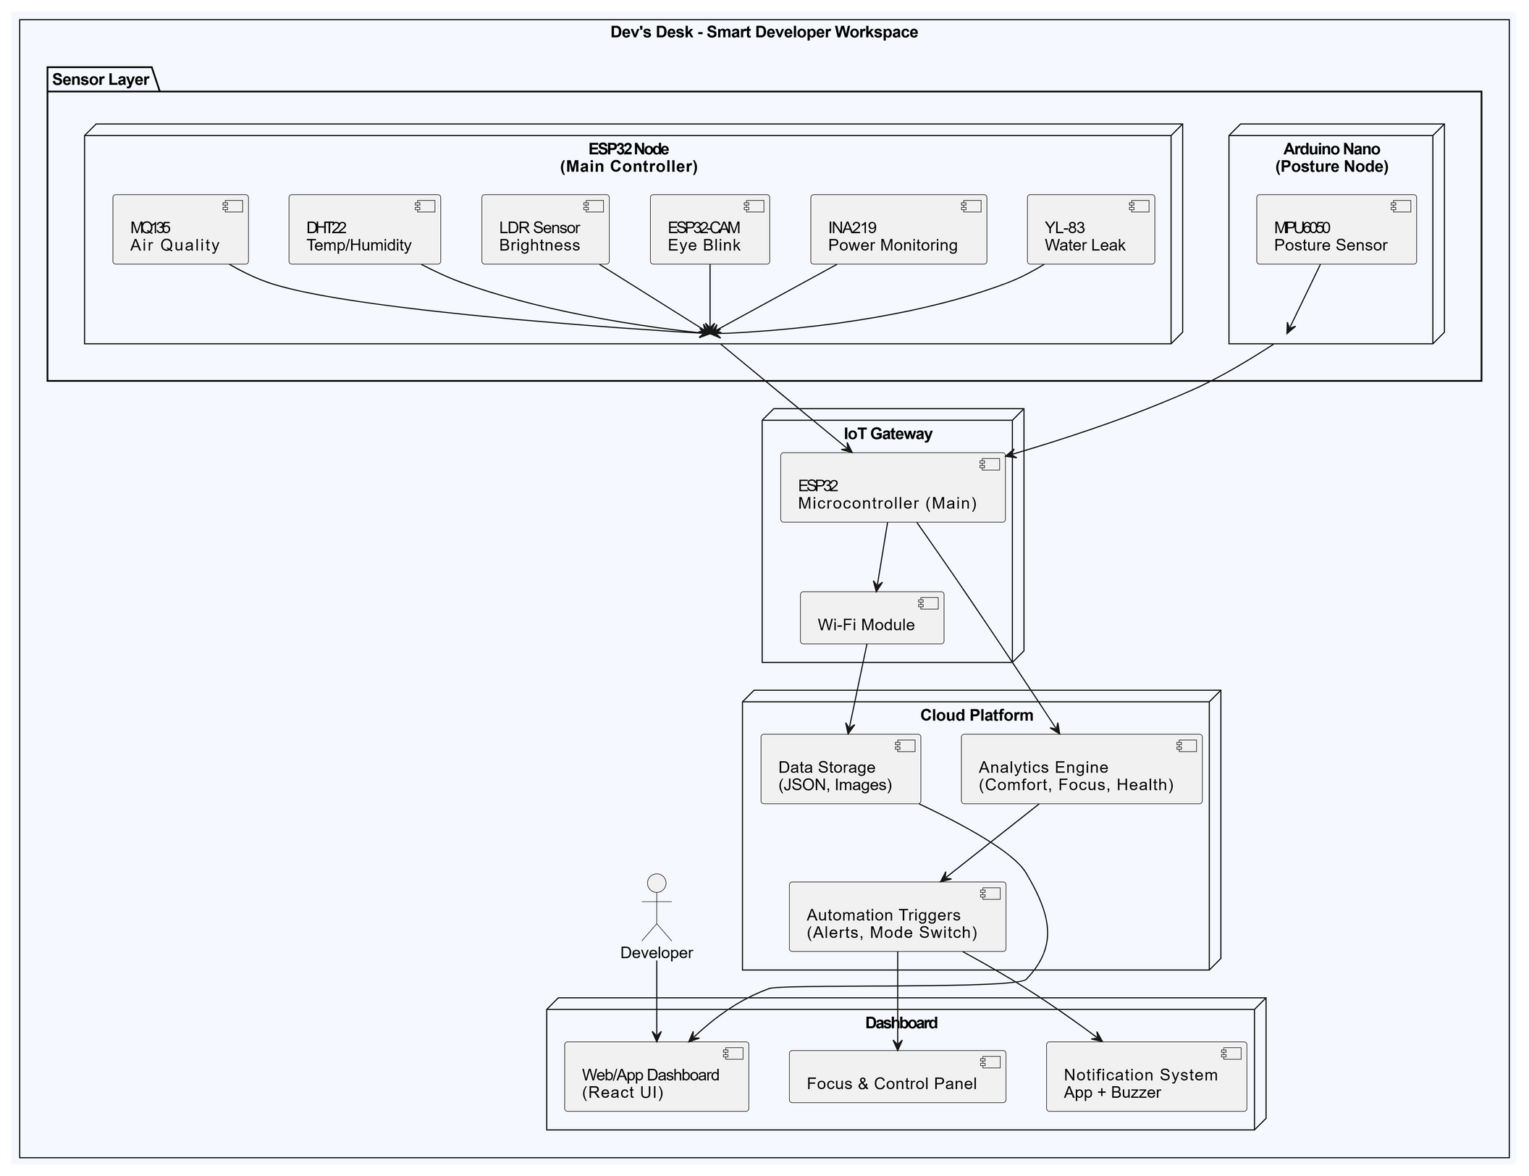
STEP 8 : operaTIONAL VIEW
THE OPERATIONAL VIEW ILLUSTRATES HOW DEV’S DESK COMPONENTS INTERACT IN REAL-TIME.
IT SHOWS SENSORS (CONNECTED TO ARDUINO NANO AND ESP32) COLLECTING DATA LIKE POSTURE, EYE STRAIN, AIR QUALITY, AND POWER USAGE.
THESE ARE PROCESSED BY THE ESP32 MICROCONTROLLER, WHICH ACTS AS THE IOT GATEWAY, TRANSMITTING DATA TO THE CLOUD. CLOUD SERVICES HANDLE ANALYTICS, AUTOMATION, AND STORAGE.
THE REACT-BASED DASHBOARD THEN PRESENTS THIS DATA TO USERS WITH SMART NOTIFICATIONS AND FOCUS CONTROLS, ENSURING AN INTELLIGENT AND RESPONSIVE WORKSPACE EXPERIENCE.
01
02
03
04

Slide 18
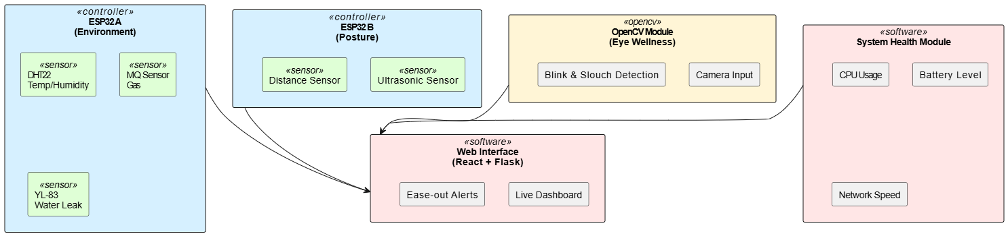
STEP 10 : DEVICE & COMPONENTS INTEGRATION
1. ESP32 (ENVIRONMENT MONITORING)
Connected Sensors:
DHT22 (Temp & Humidity)
MQ-series (Gas)
YL-83 (Water Leak)
Function: Sends real-time data to Flask server.
2. ESP32 (Posture Monitoring)
Connected Sensors:
Ultrasonic Sensor
Distance Sensor
Function: Detects neck/head position for posture correction.
Sends data to Flask server.
3. OPENCV MODULE (EYE WELLNESS)
Uses: Laptop/PC camera.
Function: Detects blink rate and slouch.
Sends alerts to Flask.
4. System Health Module
Monitors: CPU, battery, network (via Python).
Function: Tracks device health and performance
5. WEB INTERFACE
FRONTEND: REACT
BACKEND: FLASK
DISPLAYS: SENSOR VALUES, POSTURE, EYE ALERTS, SYSTEM STATS.

Slide 19
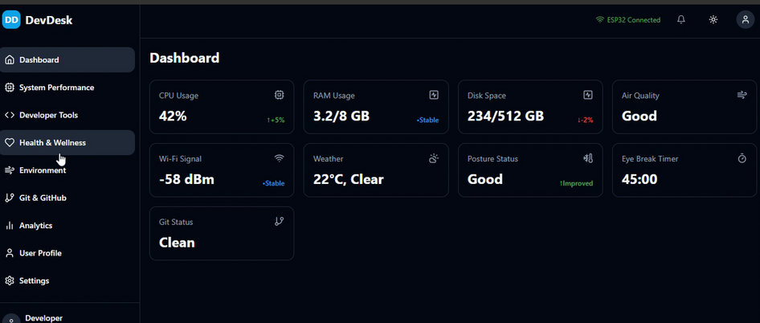
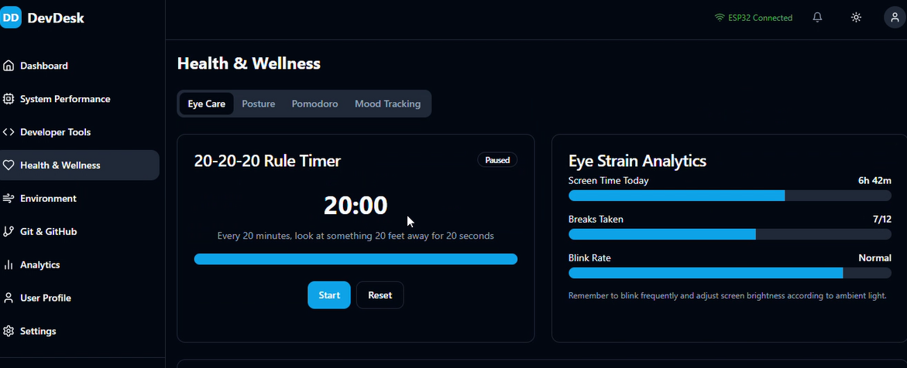
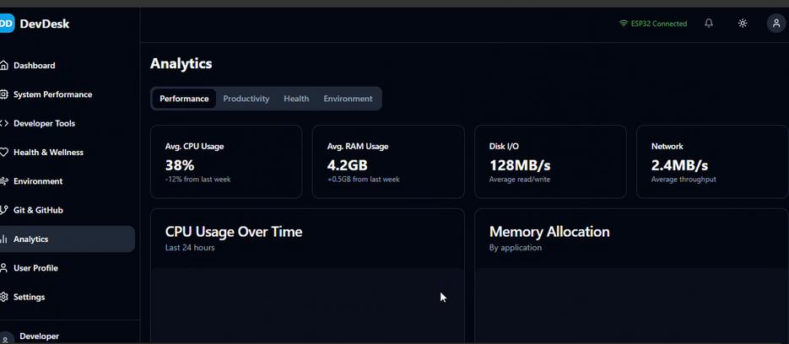
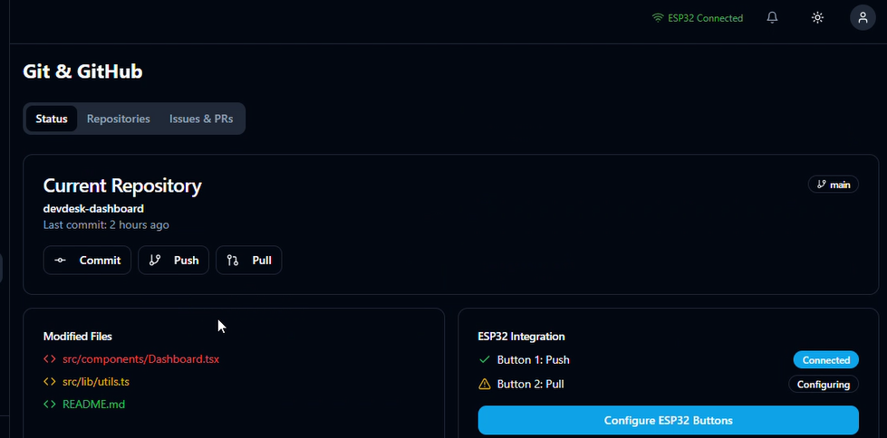
STEP 10 : APPLICATION DEVELOPMENT
Build Dev Desk using Flask for backend, React for frontend, and HTTP protocol for smooth communication between client and server.

Slide 20
FUTURE ENHANCEMENTS
The DevDesk smart workstation has the potential for significant growth by integrating more advanced sensors, such as heart rate monitors or stress detection tools, to provide a comprehensive understanding of user well-being. With the addition of these sensors, the workstation could monitor not just physical posture but also emotional states, offering a more holistic approach to health management. Additionally, refining the AI algorithms to enhance predictive analytics could allow the system to anticipate user fatigue based on their activity patterns, providing real-time feedback and interventions to optimize work performance. The workstation could proactively suggest breaks or changes in posture, promoting better physical and mental health.
Another avenue for improvement is integrating DevDesk with productivity tools like task management software, enabling users to seamlessly track progress and manage their workload in one unified platform. This would foster higher engagement and productivity. Improving the system's adaptability is also key; by learning user preferences over time, the workstation could automatically adjust settings such as lighting, seating position, and screen display to maximize comfort and focus. Scaling the system to accommodate a wider range of workstations and different environments would make it a versatile solution, suitable not only for individual use but also for large organizations looking to enhance workplace well-being and performance.

Slide 21
REFERENCES
THE EFFECTS OF BREAKS ON DIGITAL EYE STRAIN, DRY EYE, AND BINOCULAR VISION
SUMMARY: INVESTIGATES THE IMPACT OF REGULAR BREAKS, INCLUDING THE 20/20/20 RULE, ON ALLEVIATING DIGITAL EYE STRAIN AND IMPROVING BINOCULAR VISION.
TURNING TIME FROM ENEMY INTO ALLY USING THE POMODORO TECHNIQUE
SUMMARY: EXPLORES THE APPLICATION OF THE POMODORO TECHNIQUE IN AGILE SOFTWARE DEVELOPMENT TO ENHANCE PRODUCTIVITY AND TIME MANAGEMENT.
RAO, K. S., & GUPTA, M. (2020). A COMPREHENSIVE IOT-BASED SYSTEM FOR REAL-TIME POSTURE AND EYE STRAIN MONITORING. INTERNATIONAL JOURNAL OF HUMAN-COMPUTER INTERACTION, 36(1), 45-59.
BENNETT, M. A., ROSS, J. L., & HOUGHTON, D. A. (2018). UNDERSTANDING EFFORT REGULATION: COMPARING 'POMODORO' BREAKS AND SELF-REGULATED BREAKS. JOURNAL OF BEHAVIORAL SCIENCE, 29(3), 112-118.
MARTIN GARCIA, S., & FERRER, J. C. (2019). TURNING TIME FROM ENEMY INTO ALLY USING THE POMODORO TECHNIQUE. INTERNATIONAL JOURNAL OF PRODUCTIVITY MANAGEMENT, 11(4), 55-62.
CHEN, M. S., LEE, Y. L., WEI, H. M., & LIN, J. Y. (2021). THE EFFECTS OF BREAKS ON DIGITAL EYE STRAIN, DRY EYE, AND BINOCULAR VISION. JOURNAL OF OCCUPATIONAL HEALTH, 63(2), 210-219.

